Slide 1

Software Engineering (2305CS202)
Unit-3 Software Analysis
& Design
Prof. Devangi L. Kotak
Darshan Institute of Computer Application
Devangi.kotak@darshan.ac.in

Slide 2

Looping
Outline
Requirement Engineering
Software Requirements Specification
Eliciting Requirements
Developing Use case
Requirement Modeling

Slide 3



Requirements analysis is hard
“The hardest single part of building a software system is deciding what to build. No part of the work so cripples the
resulting system if done wrong.”
“The seeds of major software disasters are usually sown in the
first three months of commencing the software project.”
What is Requirement Engineering?
Tasks and techniques that lead to an understanding of requirements is called requirement engineering.
"Fred" Brooks Jr. is an American computer architect, software engineer, and computer scientist, best known for managing the development of IBM's System/360 family of computers
Capers Jones is an American specialist in software engineering methodologies

Slide 4
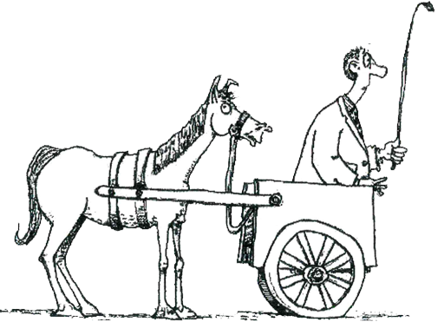
Requirement Engineering
It provides the appropriate mechanism for understanding
Requirements fall into two types
Functional requirements
Non-Functional requirements
What customer wants
Non-Functional requirements
Functional requirements
Analyzing needs
Assessing feasibility
Negotiating a reasonable solution
Specifying solution unambiguously
Validating the specification
Managing requirements
Don't put what you want to do - before how you need to do it

Slide 5
Functional requirements
Non-functional requirements
Any requirement which specifies what the system Should do.
Any requirement which specifies how the system performs a certain function.
A functional requirement will describe a particular behaviour of function of the system when certain conditions are met, for example: “Send email when a new customer signs up” or “Open a new account”.
A non-functional requirement will describe how a system should behave and what limits there are on its functionality.
Typical functional requirements
Typical non-functional requirements
Business Rules
Administrative functions
Historical Data
Response time
Availability
Regulatory
Transaction corrections, adjustments and cancellations
Legal or Regulatory Requirements
Throughput
Reliability
Manageability
Utilization
Recoverability
Environmental
External Interfaces
Reporting Requirements
Authentication
Static volumetric
Maintainability
Data Integrity
Authorization levels
Scalability
Serviceability
Usability
Audit Tracking
Capacity
Security
Interoperability

Slide 6
Library Management System
Function Requirements
Non-function Requirements
Add Article: New entries must be entered in database
Update Article: Any changes in articles should be updated in case of update
Delete Article: Wrong entry must be removed from system
Inquiry Members: Inquiry all current enrolled members to view their details
Inquiry Issuance: Inquiry all database articles
Check out Article: To issue any article must be checked out
Check In article: After receiving any article system will reenter article by Checking
Inquiry waiting for approvals: Librarian will generates all newly application which is in waiting list
Reserve Article: This use case is used to reserve any book with the name of librarian, it can be pledged
Safety Requirements: The database may get crashed at any certain time due to virus or operating system failure. So, it is required to take the database backup.
Security Requirements: We are going to develop a secured database for the university. There are different categories of users namely teaching staff, administrator, library staff ,students etc., Depending upon the category of user the access rights are decided.
Software Constraints: The development of the system will be constrained by the availability of required software such as database and development tools.

Slide 7



Requirements Engineering Tasks
1
Inception
2
Elicitation (Requirement Gathering)
3
Elaboration
Roughly define scope
Define requirements
Further define requirements
A basic understanding of a problem, people who want a solution, the nature of solution desired
The practice of collecting the requirements of a system from users, customers and other stakeholders
Expand and refine requirements obtained from inception & elicitation
Creation of User scenarios, extract analysis class and business domain entities

Slide 8


Requirements Engineering Tasks Cont.
4
Negotiation
5
Specification
Reconcile conflicts
Create analysis model
Agree on a deliverable system that is realistic for developers and customers
It may be written document, set of graphical models, formal mathematical model, collection of user scenarios, prototype or collection of these
SRS (Software Requirement Specification) is a document that is created when a detailed description of all aspects of software to build must be specified before starting of project

Slide 9


Requirements Engineering Tasks Cont.
6
Validation
7
Requirements Management
Ensure quality of requirements
It is a set of activities to identify, control & trace requirements & changes to requirements (Umbrella Activities) at any time as the project proceeds.
Review the requirements specification for errors, ambiguities, omissions (absence) and conflicts

Slide 10



Elicitation is the Hardest Part!
Project Inception
Problems of scope
System boundaries are ill-defined
Customers will provide irrelevant information
Problems of understanding
Customers never know exactly what they want
Customers don’t understand capabilities and limitations
Customers have trouble fully communicating needs
Problems of volatility
Requirements always change
During the initial project meetings, the following tasks should be accomplished
Identify the project stakeholders
These are the folks we should be talking to
Recognize multiple viewpoints
Stakeholders may have different (and conflicting) requirements
Work toward collaboration
It’s all about reconciling conflict
Ask the first questions
Who? What are the benefits? Another source?
What is the problem? What defines success? Other constraints?
Am I doing my job right?

Slide 11


Collaborative Elicitation
Elicitation work products
Collaborative elicitation should result in several work products
A bounded statement of scope
A list of stakeholders
A description of the technical environment
A list of requirements and constraints
Any prototypes developed
A set of use cases
Characterize how users will interact with the system
Use cases tie functional requirements together
One-on-one Q&A sessions rarely succeed in practice; collaborative strategies are more practical

Slide 12
Quality Function Deployment (QFD)
This is a technique that translates the needs of the customer into technical requirements for software
It emphasizes an understanding of what is valuable to the customer and then deploys these values throughout the engineering process through functions, information, and tasks
It identifies three types of requirements
Normal requirements: These requirements are the objectives and goals stated for a product or system during meetings with the customer
Expected requirements: These requirements are implicit to the product or system and may be so fundamental that the customer does not explicitly state them
Exciting requirements: These requirements are for features that go beyond the customer's expectations and prove to be very satisfying when present

Slide 13



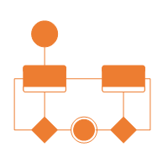
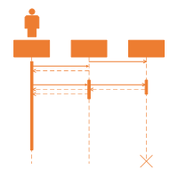
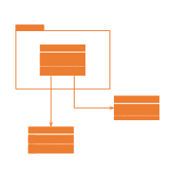
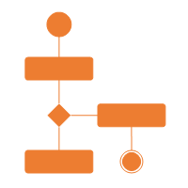
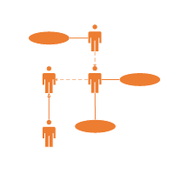
The requirement analysis model
Purpose
Describe what the customer wants built
System Information
Establish the foundation for the software design
System Function
Provide a set of validation requirements
System Behaviors

Slide 14

Analysis rule of Thumb
Elements of the Requirements Model
Make sure all points of view are covered
Every element should add value
Keep it simple
Maintain a high level of abstraction
Focus on the problem domain
Minimize system coupling
Model should provides value to all stakeholders
Scenario-based Models
e.g.
Use cases
User Stories
Class Models
e.g.
Class diagrams
Collaboration diagrams
Software
Requirements
Behavioral Models
e.g.
State diagrams
Sequence diagrams
Flow Models
e.g.
DFDs
Data models

Slide 15
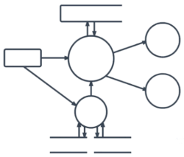
Elements of the Requirements Model Cont.
Scenario-based elements
Behavioral elements
Describe the system from the user's point of view using scenarios that are depicted (stated) in use cases and activity diagrams
Use state diagrams to represent the state of the system, the events that cause the system to change state, and the actions that are taken as a result of a particular event. This can also be applied to each class in the system.
Class-based elements
Identify the domain classes for the objects manipulated by the actors, the attributes of these classes, and how they interact with one another; which utilize class diagrams to do this.
Flow-oriented elements
Use data flow diagrams to show the input data that comes into a system, what functions are applied to that data to do transformations, and what resulting output data are produced.
Use Case Diagram
Activity Diagram
Class Diagram
State Diagram
Data Flow Diagram

Slide 16
Characteristics of a Good SRS
SRS should be accurate, complete, efficient, and of high quality, so that it does not affect the entire project plan.
An SRS is said to be of high quality when the developer and user easily understand the prepared document.
Characteristics of a Good SRS:
Correct
Unambiguous
Complete
SRS is correct when all user requirements are stated in the requirements document.
SRS is unambiguous when every stated requirement has only one interpretation.
SRS is complete when the requirements clearly define what the software is required to do.
Note that there is no specified tool or procedure to assure the correctness of SRS.

Slide 17
Characteristics of a Good SRS Cont.
Ranked for Importance/Stability
Modifiable
All requirements are not equally important, hence each requirement is identified to make differences among other requirements.
The requirements of the user can change, hence requirements document should be created in such a manner that those changes can be modified easily.
Stability implies the probability of changes in the requirement in future.
Traceable
Verifiable
Consistent
SRS is traceable when the source of each requirement is clear and facilitates the reference of each requirement in future.
SRS is verifiable when the specified requirements can be verified with a cost-effective process to check whether the final software meets those requirements.
SRS is consistent when the subsets of individual requirements defined do not conflict with each other.

Slide 18
Problems Without SRS
Without developing the SRS document, the system would not be properly implemented according to customer needs.
Software developers would not know whether what they are developing is what exactly is required by the customer.
Without SRS, it will be very difficult for the maintenance engineers to understand the functionality of the system.
It will be very difficult for user document writers to write the users’ manuals properly without understanding the SRS.

Slide 19
Standard Template for writing SRS
1. Introduction
1.1 Purpose
1.2 Document Conventions
1.3 Intended Audience and Reading Suggestions
1.4 Project Scope
1.5 References
2. Overall Description
2.1 Product Perspective
2.2 Product Features
2.3 User Classes and Characteristics
2.4 Operating Environment
2.5 Design and Implementation Constraints
2.6 User Documentation
2.7 Assumptions and Dependencies
3. System Features
3.1 System Feature 1
3.2 System Feature 2 (and so on)
4. External Interface Requirements
4.1 User Interfaces
4.2 Hardware Interfaces
4.3 Software Interfaces
4.4 Communications Interfaces
5. Other Nonfunctional Requirements
5.1 Performance Requirements
5.2 Safety Requirements
5.3 Security Requirements
5.4 Software Quality Attributes
6. Other Requirements
Appendix A: Glossary | Appendix B: Analysis Models | Appendix C: Issues List

Slide 20

Looping
Outline
What is Design?
Software design work products
Characteristics of good Design
Design Models
The FURPS quality attributes
Design Concepts
Design Principles
Architectural Design & Styles
Component Level or Procedural Design
Cohesion & Coupling
User Interface Design
Golden Rules of User Interface Design
Web Application Design

Slide 21
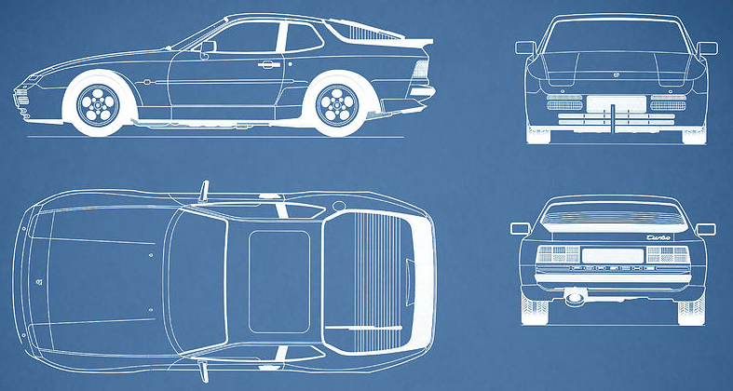
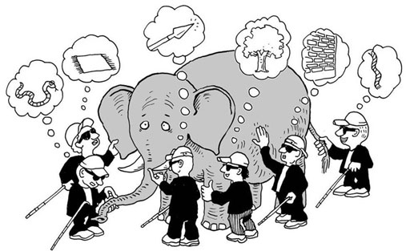
What is Design?
A meaningful representation of something to be built
It's a process by which requirements are translated into blueprint for constructing a software
Blueprint gives us the holistic view (entire view) of a software
SRS
Design
Process
Software
Design
Problem
Domain
Solution
Domain

Slide 22


Software Design Process?
Software design is the most creative part of the development process
Requirement
Engineering
Analysis
Model
Design
Engineering
Design
Model
Process involves
Diversification & Convergence
Blue Print for Constructing Software

Slide 23
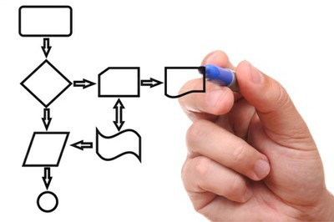
Software design work products
Characteristics of good Design
For a design to be easily implemented in a conventional programming language, the following items must be designed during the design phase.
The design must implement all explicit requirements available in requirement model
The design must accommodate all implicit requirements given by stakeholders
The design must be readable & understandable
The good design should provide complete picture of the software, addressing the data, functional and behavioral domains.
Different modules required to implement the design solution.
Control relationship among the identified modules. The relationship is also known as the call relationship or invocation relationship among modules.
Interface among different modules. The interface among different modules identifies the exact data items exchanged among the modules.
Algorithms required to implement each individual module.
Data structures of the individual modules.

Slide 24
Design Concepts
The beginning of wisdom for a software engineer is to recognize the difference between getting program to work and getting it right
Fundamental software design concepts provide the necessary framework
for
“getting it right.”
Each design concept helps to answer the following questions
What criteria can be used to partition software into individual components?
How is function or data structure detail separated from a conceptual representation of the software?
What uniform criteria define the technical quality of a software design?

Slide 25
Important Software Design Concepts
Abstraction - Hide Irrelevant data
Modularity - subdivide the system
Architecture - design a structure of something
Refinement - removes impurities
Pattern - a Repeated form
Information Hiding - Hide the Information so that it cannot be accessed by an unwanted party
Refactoring - Reconstruct something

Slide 26
Design Models
It is creative activity. It is most critical activity during system development
Analysis Models
Has great impact on testing and maintenance
Scenario-based elements
Use cases - text
Use-case diagrams
Activity diagrams
Swimlane diagrams
Design document forms reference for later phases
Flow-oriented elements
Data flow diagrams
Control-flow diagrams
Processing narratives
Procedural
Design
Procedural description of Software components
Behavioral elements
State diagrams
Sequence diagrams
Interface Design
Human computer interaction
Architectural Design
Relationship among structural elements
Class-based elements
Class diagrams
Analysis packages
CRC models
Collabortion diagrams
Data/Class Design
Data Structure

Slide 27


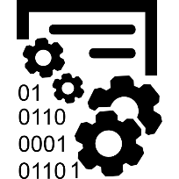

Design Models Cont.
Data Design
Architectural Design
Interface Design
Procedural Design
It transforms structural elements of software into procedural description of software components
It transforms class models into design class realization and prepares data structure (data design) required to implement the software.
It defines the relationship between major structural elements of the software
It defines how software communicates with systems & with humans. An interface implies flow of information & behavior.

Slide 28
Quality attributes of software design
The FURPS quality attributes
F
Functionality
U
Usability
assessed by feature set and capabilities of the program, generality of the functions & security of overall system
assessed by considering human factors, overall aesthetics(UI/UX), consistency & documentations
R
Reliability
P
Performance
assessed by measuring frequency & severity of failures, accuracy of outputs, mean-time-of-failure (MTTF), ability to recover from errors
measured by processing speed, response time, resource consumption, throughput and efficiency
S
Supportability
Ability to extend program, adaptability, serviceability, testability, compatibility

Slide 29
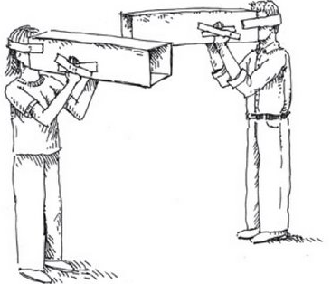
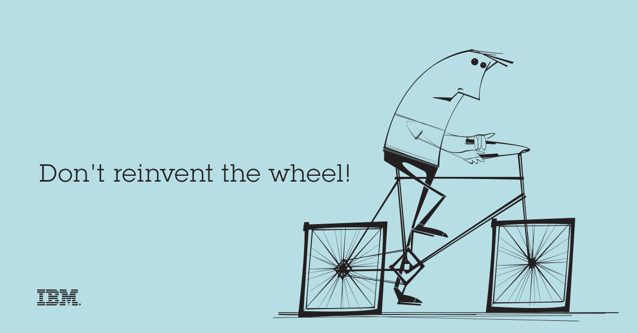

Design Principles
Design process should not suffer from “tunnel vision”
Design should be structured to degrade gently, even when abnormal data, events, or operating conditions are encountered
Design should be traceable to the analysis model
Design should not reinvent the wheel
Design is not coding, coding is not design
Design should “minimize the intellectual distance” between the software and the real world problem
Design should be assessed for quality as it is being created, not after the fact
Design should exhibit (present) uniformity and integration
Design should be reviewed to minimize conceptual (semantic) errors
Design should be structured to accommodate change
Tunnel Vision
Reinvent the Wheel
Coding
Design

Slide 30
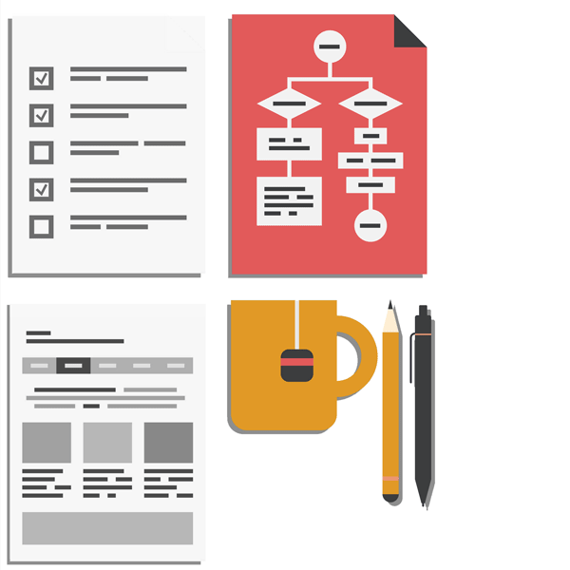

Architectural Design
Software Architecture & Design
Large systems are decomposed into subsystems
Sub-systems provide related services
Initial design process includes
Identifying sub-systems
Establishing a framework for sub-system control and communication
Why to document the Architecture?
Stakeholder Communication: High-level presentation of system
System Analysis: Big effect on performance, reliability, maintainability and other –ilities (Usability, Maintainability, Scalability, Reliability, Extensibility, Security, Portability)
Large-scale Reuse: Similar requirements similar architecture

Slide 31
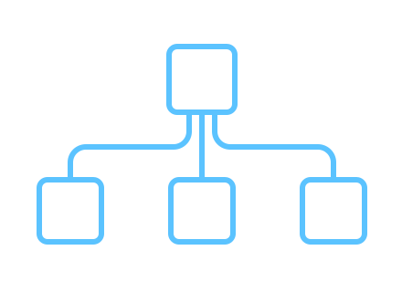

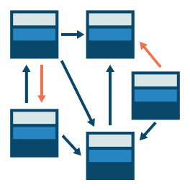
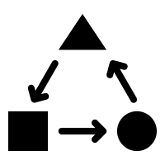
Architectural Styles
Each style describes a system category that encompasses
Data-centered architecture style
Data-flow architectures
A set of components (Ex., a database, computational modules) that perform a function required by a system.
Call and return architecture
Object-oriented architecture
A set of connectors that enable “communication, coordination and cooperation” among components.
Layered architecture
Constraints that define how components can be integrated to form the system.
Semantic models that enable a designer to understand the overall properties of a system.

Slide 32
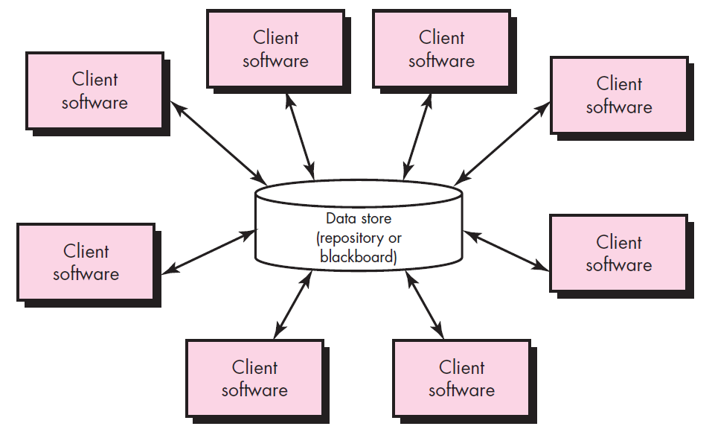
Data-centered architecture style
A data store (Ex., a file or database) resides at the center of this architecture and is accessed frequently by other components.
Client software accesses a central repository.
In some cases the data repository is passive
That is, client software accesses the data independent of any changes to the data or the actions of other client software.

Slide 33
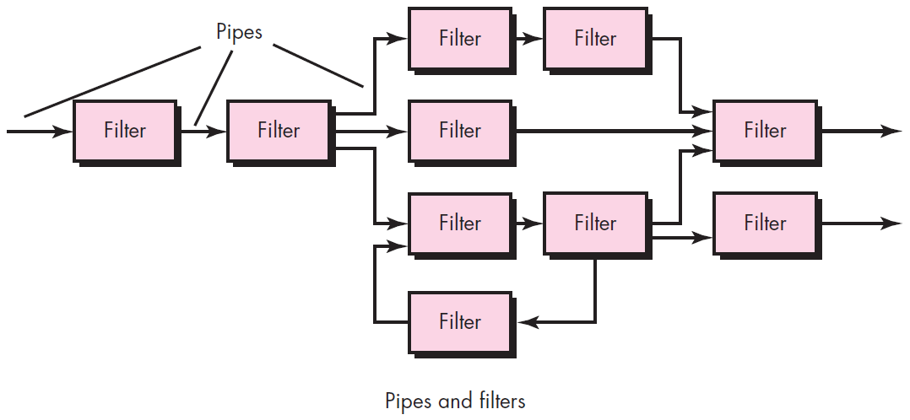
Data-flow architectures
This architecture is applied when input data are to be transformed.
A set of components (called filters) connected by pipes that transmit data from one component to the next.
Each filter works independently of those components upstream and downstream, is designed to
expect data input of a certain form, and
produces data output (to the next filter) of a specified form.

Slide 34
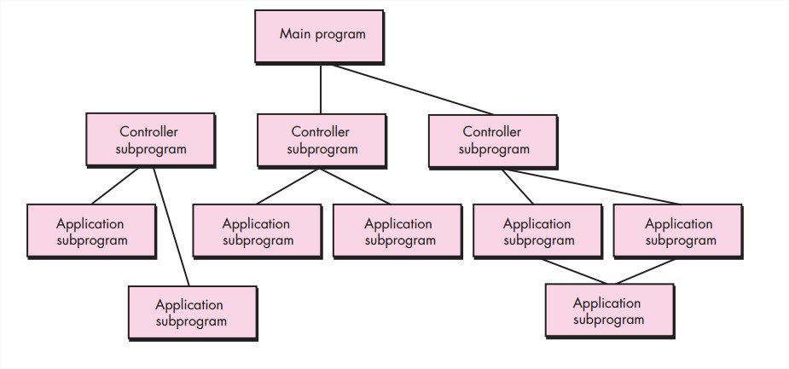
Call and return architecture
This architectural style enables a software designer (system architect) to achieve a program structure that is relatively easy to modify and scale.
A number of sub styles exist within this category as below.
Main program/subprogram architectures
This classic program structure decomposes function into a control hierarchy where a “main” program invokes a number of program components, which in turn may invoke still other components.
Remote procedure call architectures
The components of a main program/subprogram architecture are distributed across multiple computers on a network.

Slide 35
Object-oriented architecture
The components of a system encapsulate data and the operations that must be applied to manipulate the data.
Communication and coordination between components is accomplished via message passing.

Slide 36
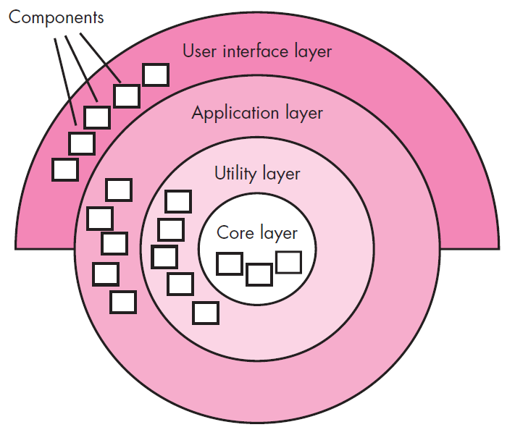
Layered architecture
A number of different layers are defined, each accomplishing operations that progressively become closer to the machine instruction set.
At the outer layer, components service user interface operations.
At the inner layer, components perform operating system interfacing.
Intermediate layers provide utility services and application software functions.

Slide 37

Component Level or Procedural Design
Component is a modular, deployable and replaceable part of a system that encapsulates implementation and exposes a set of interfaces.
Component-level design occurs after data, architectural and interface designs have been established.
It defines the data structures, algorithms, interface characteristics, and communication mechanisms allocated to each component.
The intent is to translate the design model into operational software.
But the abstraction level of the existing design model is relatively high and the abstraction level of the operational program is low.
Effective programmers should not waste their time in debugging, they should not introduce bug to start with

Slide 38
Function Oriented Approach
The following are the features of a typical function-oriented design approach:
A system is viewed as something that performs a set of functions.
Starting at this high level view of the system, each function is successively refined into more detailed functions.
For example, consider a function create-new-library member
which essentially creates the record for a new member, assigns a unique membership number to him, and prints a bill towards his membership charge.
This function may consist of the following sub-functions:
assign-membership-number, create-member-record and print-bill
Each of these sub-functions may be split into more detailed sub-functions and so on.
The system state is centralized and shared among different functions.
For Ex., data such as member-records is available for reference and updating to several functions such as:
create-new-member
delete-member
update-member-record

Slide 39
Object Oriented Approach
In the object-oriented design approach, the system is viewed as collection of objects (i.e., entities).
The state is decentralized among the objects and each object manages its own state information.
For example, in a Library Automation Software,
each library member may be a separate object with its own data and functions to operate on these data.
In fact, the functions defined for one object cannot refer or change data of other objects.
Objects have their own internal data which define their state.

Slide 40
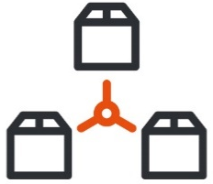



Cohesion & Coupling
A good software design implies clean decomposition of the problem into modules, and the neat arrangement of these modules in a hierarchy.
The primary characteristics of neat module decomposition are high cohesion and low coupling.
A cohesive module performs a single task, requiring little interaction with other components.
A Coupling is an indication of the relative interdependence among modules.

Slide 41
Cohesion
Classification of Cohesion
Cohesion is an indication of the relative functional strength of a module.
A cohesive module performs a single task, requiring little interaction with other components.
Stated simply, a cohesive module should (ideally) do just one thing.
A module having high cohesion and low coupling is said to be functionally independent of other modules.
By the term functional independence, we mean that a cohesive module performs a single task or function.
Classification of Cohesion
Coincidental
Low
Logical
Temporal
Procedural
Communicational
Sequential
Functional
High

Slide 42
Classification of Cohesion cont.
Coincidental cohesion
Logical cohesion
A module is said to have coincidental cohesion, if it performs a set of tasks that relate to each other very loosely.
In this case, the module contains a random collection of functions.
It is likely that the functions have been put in the module out of pure coincidence without any thought or design.
For Ex., in a transaction processing system (TPS), the get-input, print-error, and summarize-members functions are grouped into one module
At the outer layer, components service user interface operations.
A module is said to be logically cohesive, if all elements of the module perform similar operations.
For Ex., error handling, data input, data output, etc.
An example of logical cohesion is the case where a set of print functions generating different output reports are arranged into a single module In this case, the module contains a random collection of functions.

Slide 43
Classification of Cohesion cont.
Temporal cohesion
Procedural cohesion
When a module contains functions that are related by the fact that all the functions must be executed in the same time span.
For Ex., the set of functions responsible for initialization, start-up, shutdown of some process, etc.
If the set of functions of the module are all part of a procedure (algorithm) in which certain sequence of steps have to be carried out for achieving an objective
For Ex., the algorithm for decoding a message.
Communicational cohesion
If all functions of the module refer to the same data structure
For Ex., the set of functions defined on an array or a stack.

Slide 44
Classification of Cohesion cont.
Sequential cohesion
If the elements of a module form the parts of sequence, where the output from one element of the sequence is input to the next.
For Ex., In a Transaction Processing System, the get-input, validate-input, sort-input functions are grouped into one module.
Functional cohesion
If different elements of a module cooperate to achieve a single function.
For Ex., A module containing all the functions required to manage employees’ pay-roll exhibits functional cohesion.

Slide 45
Coupling
Classification of Coupling
Coupling between two modules is a measure of the degree of interdependence or interaction between the two modules.
A module having high cohesion and low coupling is said to be functionally independent of other modules.
If two modules interchange large amounts of data, then they are highly interdependent.
The degree of coupling between two modules depends on their interface complexity.
The interface complexity is basically determined by the number of types of parameters that are interchanged while invoking the functions of the module.
Classification of Coupling
Data
Low
Stamp
Control
Common
Content
High

Slide 46
Classification of Coupling Cont.
Data coupling
Stamp coupling
Two modules are data coupled, if they communicate through a parameter.
An example is an elementary (primal) data item passed as a parameter between two modules, e.g. an integer, a float, a character, etc.
This is a special case (or extension) of data coupling
Two modules (``A'' and ``B'') exhibit stamp coupling if one passes directly to the other a composite data item - such as a record (or structure), array, or (pointer to) a list or tree.
This occurs when ClassB is declared as a type for an argument of an operation of ClassA
Control coupling
If data from one module is used to direct the order of instructions execution in another.
An example of control coupling is a flag set in one module and tested in another module

Slide 47
Classification of Coupling Cont.
Common coupling
Two modules are common coupled if they share information through some global data items.
The modules can access & manipulate the same global variables & the data structures.
Content coupling
Content coupling occurs when one component secretly modifies data that is internal to another component.
This violets information hiding – a basic design concept
Content coupling exists between two modules, if they share code.

Slide 48




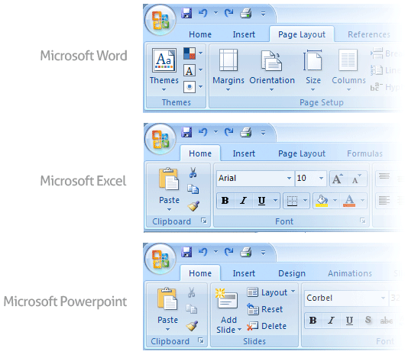
User Interface Design
Golden Rules of User Interface Design
Place the User in Control
Reduce the User’s Memory Load
Make the Interface Consistent

Slide 49
Golden Rules of User Interface Design Cont.
Place the User in Control
During a requirements-gathering session for a major new information system, a key user was asked about.
Following are the design principles that allow the user to maintain control:
Define interaction modes in a way that does not force a user into unnecessary or undesired actions.
Provide for flexible interaction
Allow user interaction to be interruptible and undoable.
Streamline interaction as skill levels advance and allow the interaction to be customized.
Hide technical internals from the casual user.
Design for direct interaction with objects that appear on the screen.

Slide 50

Golden Rules of User Interface Design Cont.
Reduce the User’s Memory Load
The more a user has to remember, the more error-prone the interaction with the system will be.
Following are the design principles that enable an interface to reduce the user’s memory load:
Reduce demand on short-term memory.
Establish meaningful defaults
Define shortcuts that are intuitive
The visual layout of the interface should be based on a real-world metaphor
Disclose information in a progressive fashion

Slide 51
Golden Rules of User Interface Design Cont.
Make the Interface Consistent
The interface should present and acquire information in a consistent fashion.
Following are the design principles that help make the interface consistent
Maintain consistency across a family of applications
If past interactive models have created user expectations, do not make changes unless there is a compelling (convincing) reason to do so

Slide 52

User Interface Analysis and Design Models
User profile model – Established by a software engineer
Establishes the profile of the end-users of the system
based on age, gender, physical abilities, education, cultural background, motivation, goals, and personality.
Design model – Created by a software engineer
Derived from the analysis model of the requirements.
Incorporates data, architectural, interface, and procedural representations of the software.
Implementation model – Created by the software implementers
Consists of the look and feel of the interface combined with all supporting information (books, videos, help files) that describe system syntax and semantics.
User's mental model – Developed by the user when interacting with the application
Often called the user's system perception.
Consists of the image of the system; that users carry in their heads.
The role of the interface designer is to merge these differences and derive a consistent representation of the interface.

Slide 53

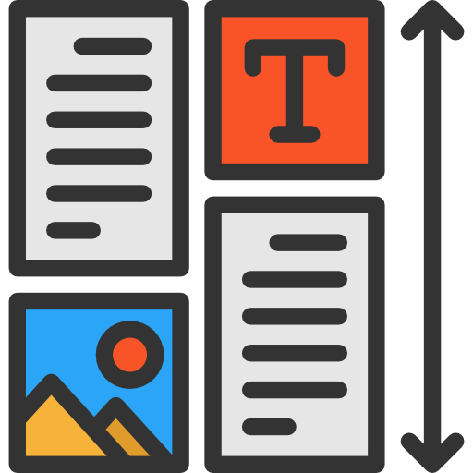
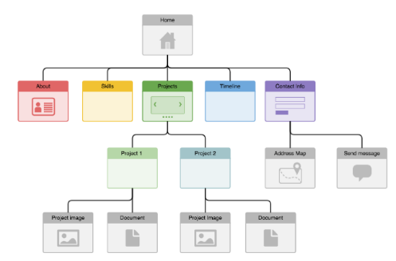


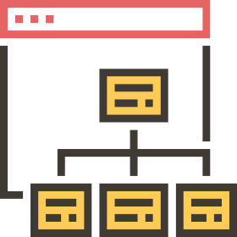
Web Application Design
Design for WebApp encompasses technical and nontechnical activities that include:
Establishing the look and feel of the WebApp
Defining the overall architectural structure
Developing the content and functionality that reside within the architecture
Planning the navigation that occurs within the WebApp

Slide 54
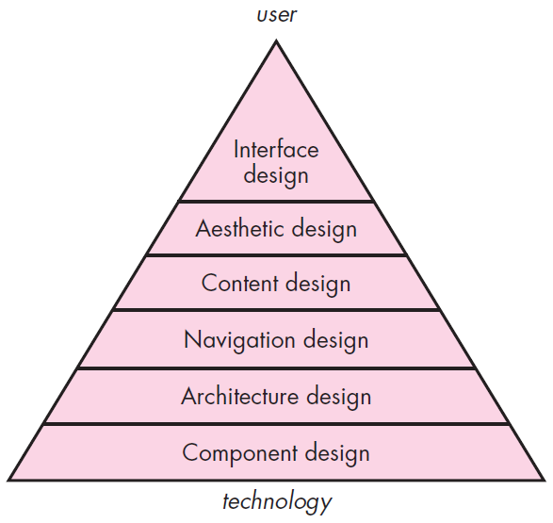
Web App Interface Design
Design pyramid for WebApps
The objectives of a WebApp interface are to
Establish a consistent window into the content and functionality provided by the interface.
Guide the user through a series of interactions with the WebApp.
Organize the navigation options and content available to the user
Interface Design
One of the challenges of interface design for WebApps is the nature of the user’s entry point.

Slide 55
Design pyramid for WebApps Cont.
Aesthetic Design
Content Design
Architecture Design
Also called graphic design, is an artistic endeavor sthat complements the technical aspects of WebApp design.
Generate content and design the representation for content to be used within a WebApp.
It is tied to the goals established for a WebApp, the content to be presented, the users who will visit, and the navigation that has been established.
Component-Level Design
Navigation Design
Modern WebApps deliver increasingly sophisticated processing functions that
Represents the navigational flow between content objects and for all WebApp functions. It describes how the user locates and interacts with the content.
Perform localized processing to generate content and navigation capability in a dynamic fashion
Provide computation or data processing capability that are appropriate for the WebApp’s business domain
Provide sophisticated database query and access
Establish data interfaces with external corporate systems

Slide 56
Software Engineering (2305CS202)
Prof. Devangi L. Kotak
Darshan Institute of Computer Application
Devangi.kotak@darshan.ac.in

